Slide 1

Big Data-2 Final Project
Supervised by:
Prof. Orren Johnson

Slide 2



Agenda
Data Analysis on TTC (Toronto Transit Commission)

Slide 3
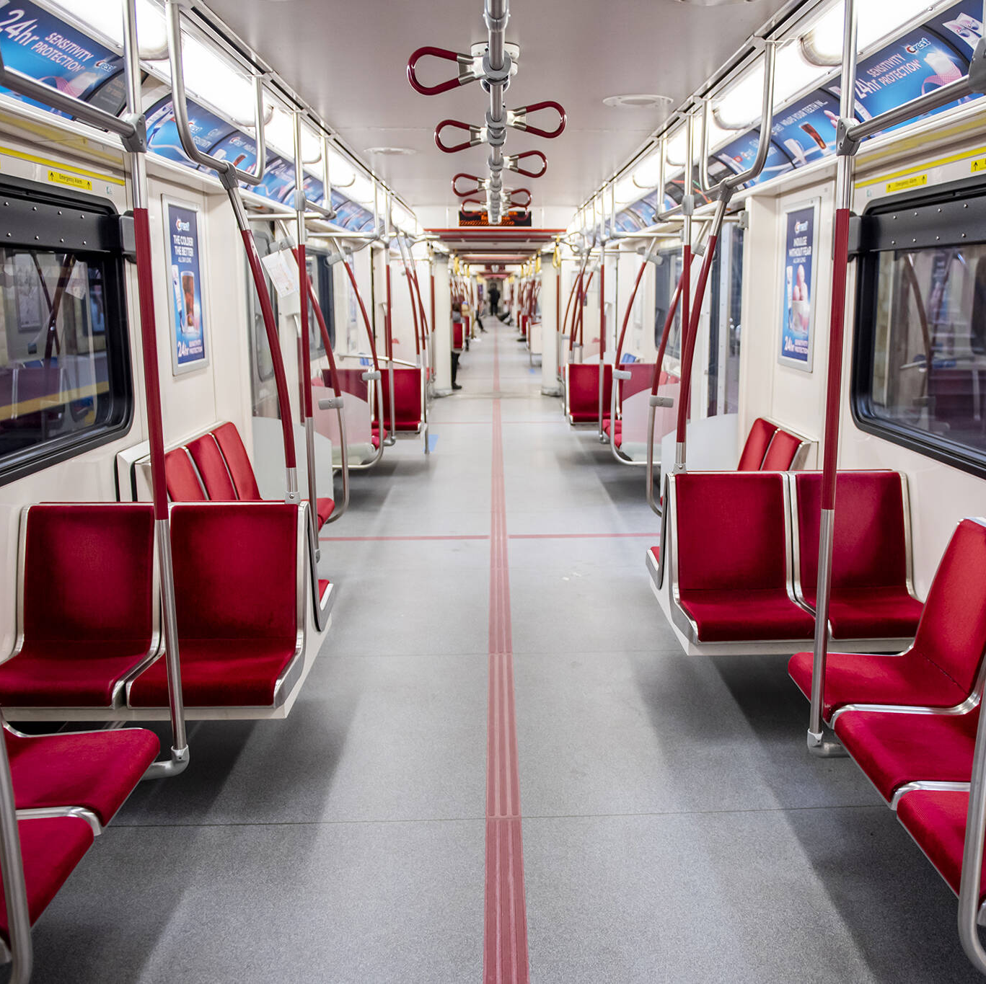
Why we choose this topic ?
We didn’t use TTC service much before in-person classes start.
When we started coming to the college, it hit our minds why not trying some analysis how TTC routes and schedules work.
To perform some findings such as which TTC bus will come at what time at what stop, where TTC bus would proceed towards.

Slide 4
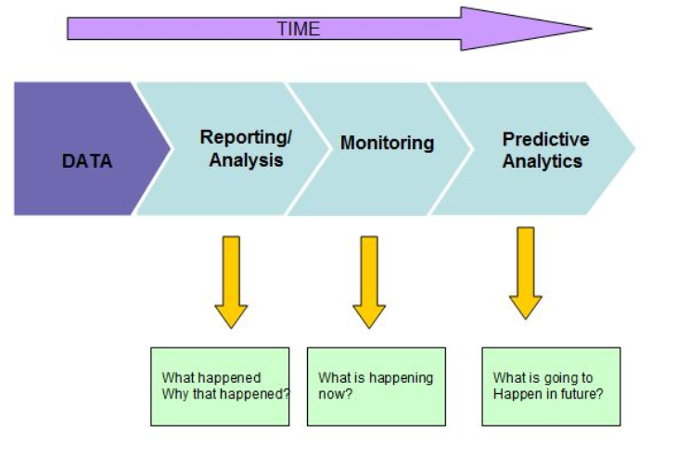
Data Mining
Since TTC schedules are already in place, Reporting or Analysis is done on data generated from the dataset provided by TTC.
Data source- https://open.toronto.ca/dataset/ttc-routes-and-schedules/
Tools used- Neo4j (Graph Data Science Library 2.0.3)
Data- Imported from 5 CSV files: shapes, routes, trips, stops, stop_times
Data accuracy- 99.9 %
Objective for analysis: To reach out to various significant and possible outcomes

Slide 5
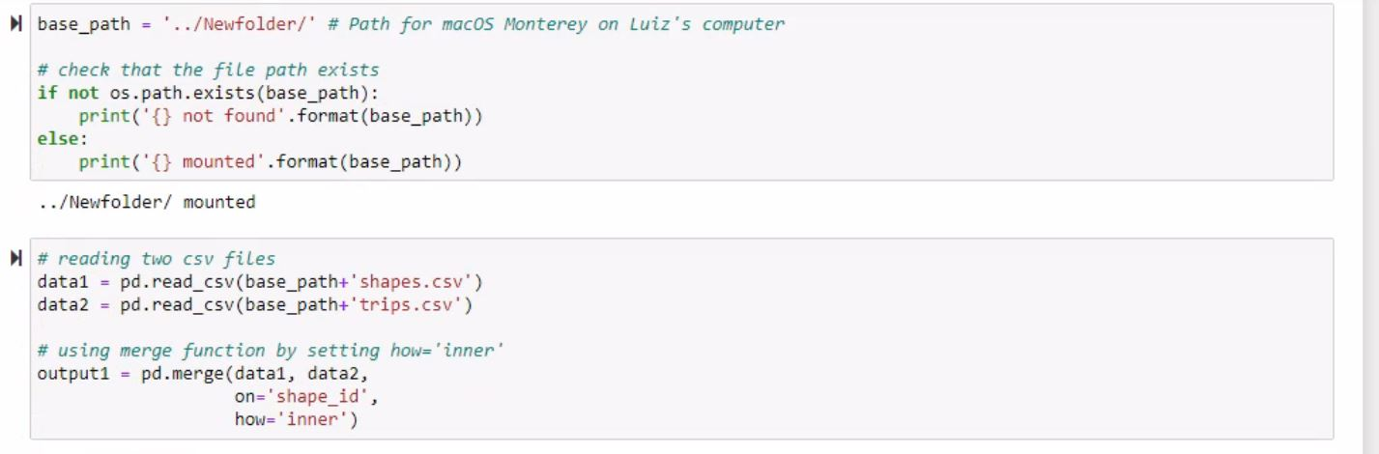
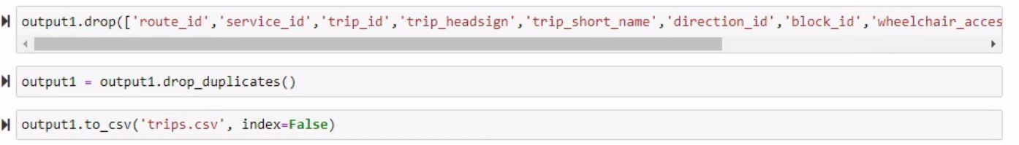
Extraction Transform Load (ETL)
At first step, entire data sets which were taken from the open.toronto.ca/dataset were tried out to create the graph database.
Neo4j threw an error for “Out of memory”.
We used Python notebook to reduce the data amount considerably from all the five CSVs
We imported CSVs data into dataframes and then removed some related data from the dataframes so that it can hamper our analysis.
Now dataframes were again converted back into CSVs.

Slide 6
Data sets
It was the major challenge to find out the correct data set for our analysis.
Our group spent around 4-5 hours only on finding the accurate data sets which we could use.
Then, we spent some more time to make it compatible with Neo4j which is running on 16 GBs of RAM machine. We reduced the number of rows for each data file.
In entire data set, we have following five CSV files:
Shapes.csv: This gives information about each vehicle TTC runs. (Buses/Subways)
Routes.csv: This signifies the map which can connect various points from source to destination.
Trips.csv: When some shape runs on routes, it is called as trip.
Stops.csv: This file contains all the data related to stop points where public wait for the TTC vehicle.
Stop_Times.csv: This is most biggest file we have in our dataset and it gives information about the times where shape takes a stop.

Slide 7
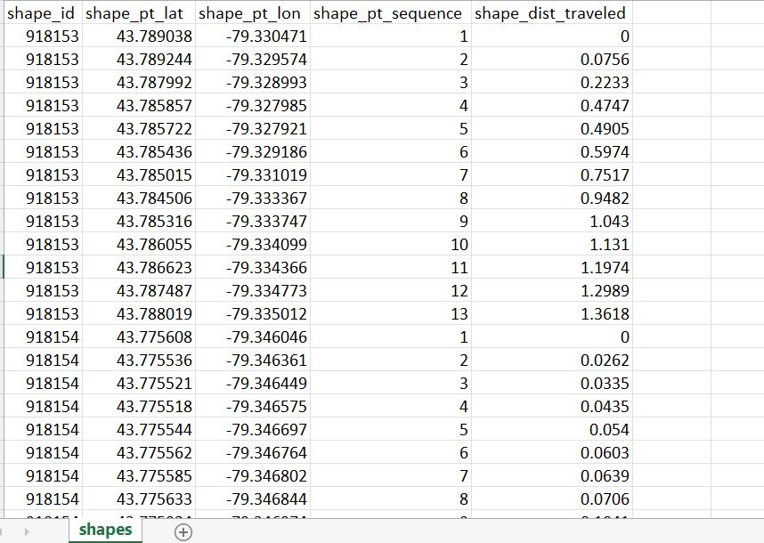
1. Shapes.csv

Slide 8
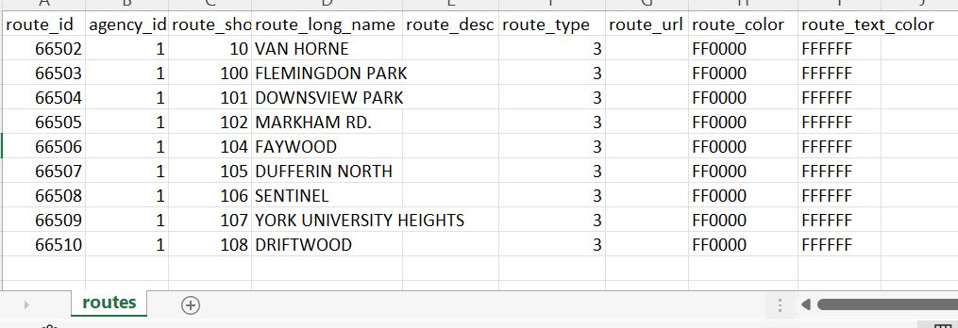
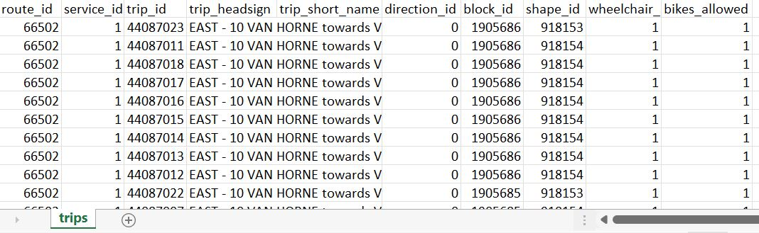
2. Routes.csv
3. Trips.csv

Slide 9
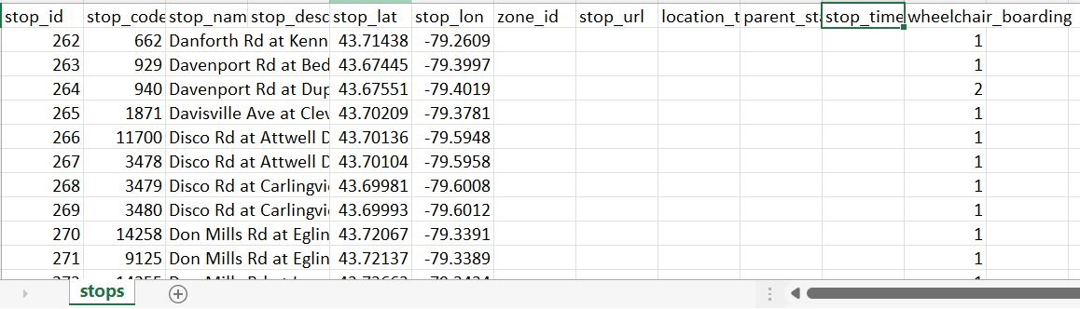
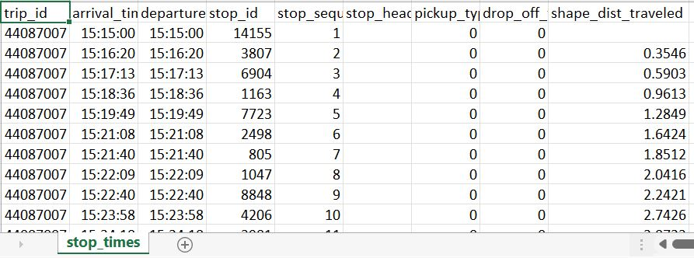
4. Stops.csv
5. Stop_Times.csv

Slide 10
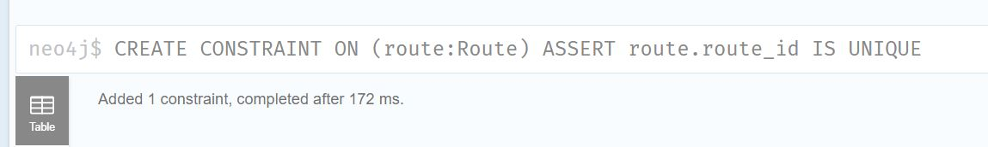
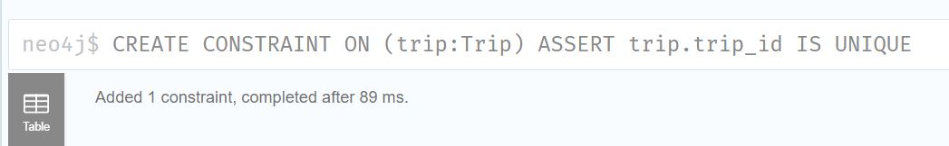
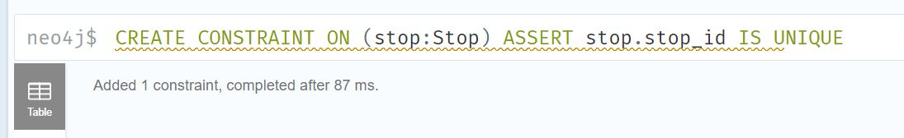
Importing data into Neo4j and creating Graph Database
- Adding Constraints:

Slide 11
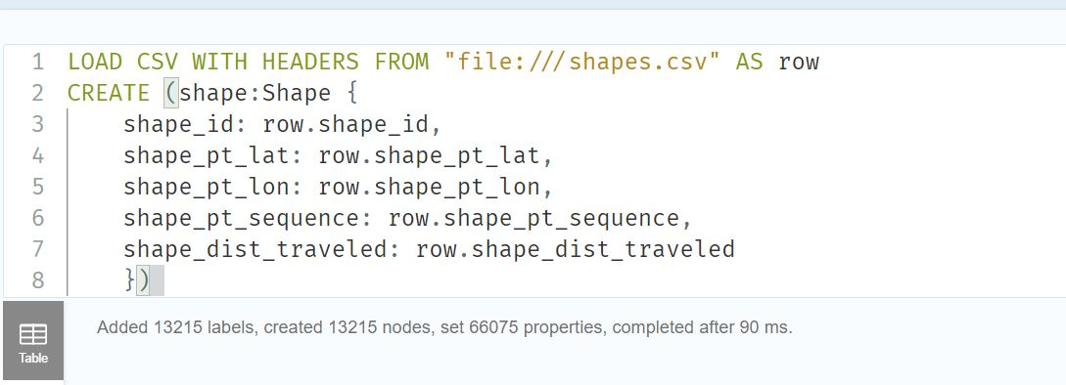
Importing data into Neo4j and creating Graph Database
- Loading shapes data:

Slide 12
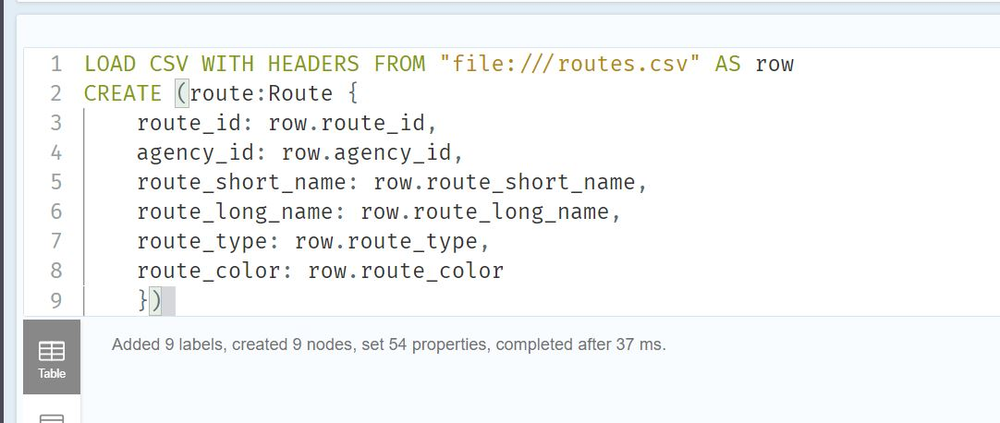
Importing data into Neo4j and creating Graph Database
- Loading routes data:

Slide 13
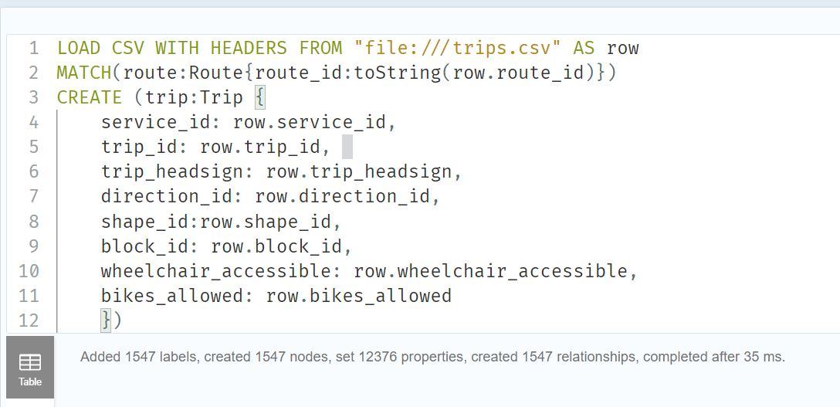
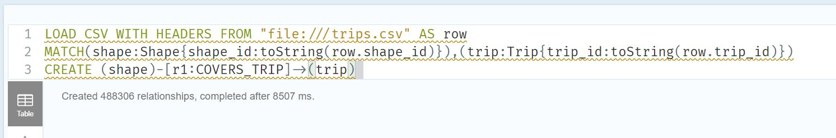
Importing data into Neo4j and creating Graph Database
- Loading trips data (also creating relationships) :

Slide 14
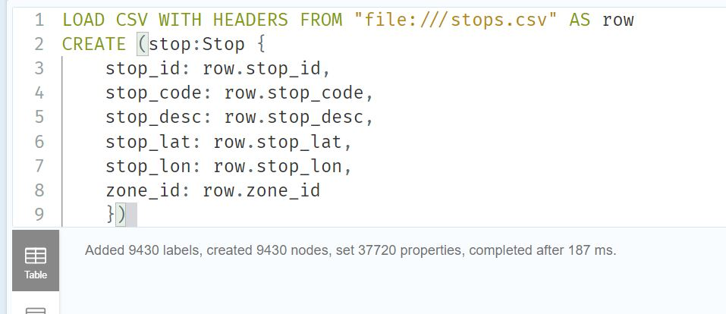
Importing data into Neo4j and creating Graph Database
- Loading stops data:

Slide 15
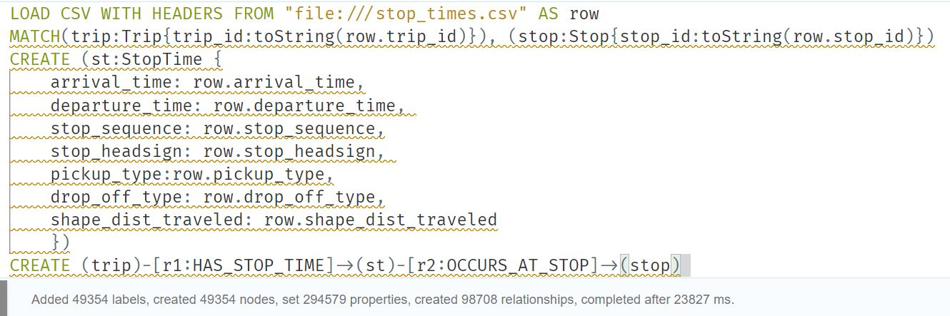
Importing data into Neo4j and creating Graph Database
- Loading stop_times data (also creating relationships) :

Slide 16
Contents of Data Analysis:
Longest route
Complete schedule of a bus/subway.
Busiest route
Bus-stop schedule
Bus-service
Shortest path
Best TTC options

Slide 17
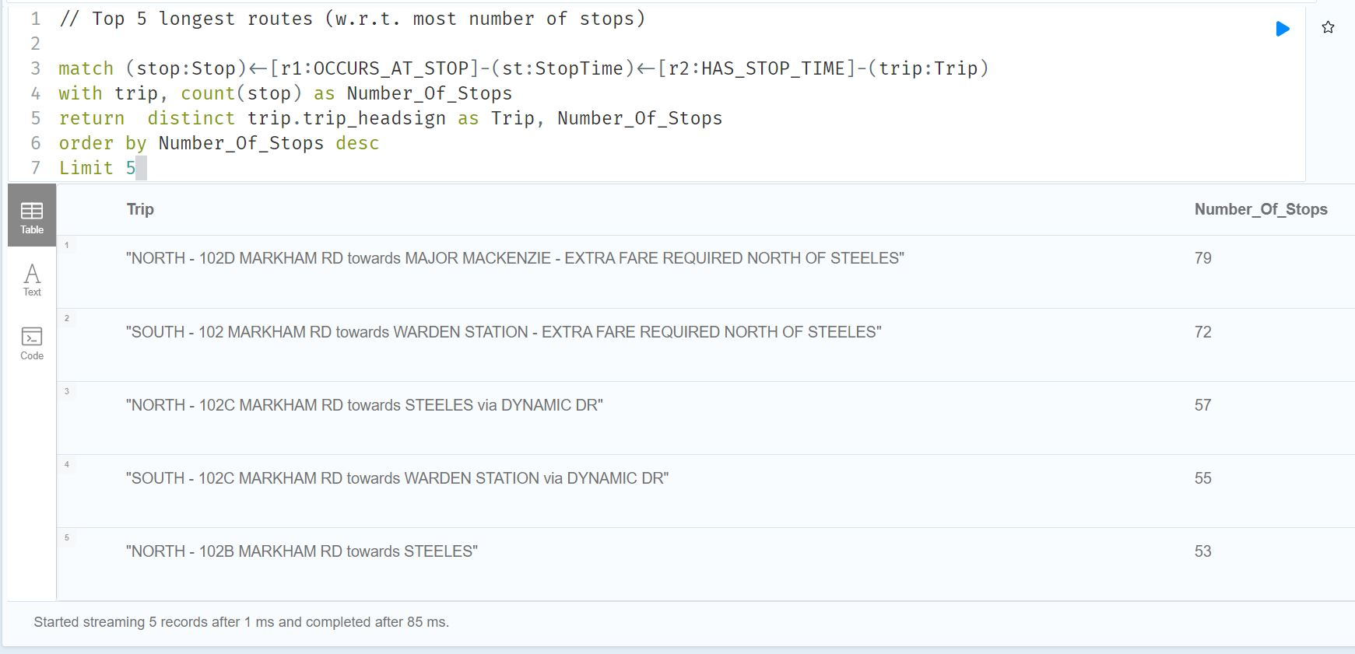
1. On the basis of number of stops, we are looking for the longest routes TTC network has. This would help us to analyze if in near future, we can break the entire route into new sub-routes. This can further reduce the delays since TTC has some added margin on the end stations.

Slide 18
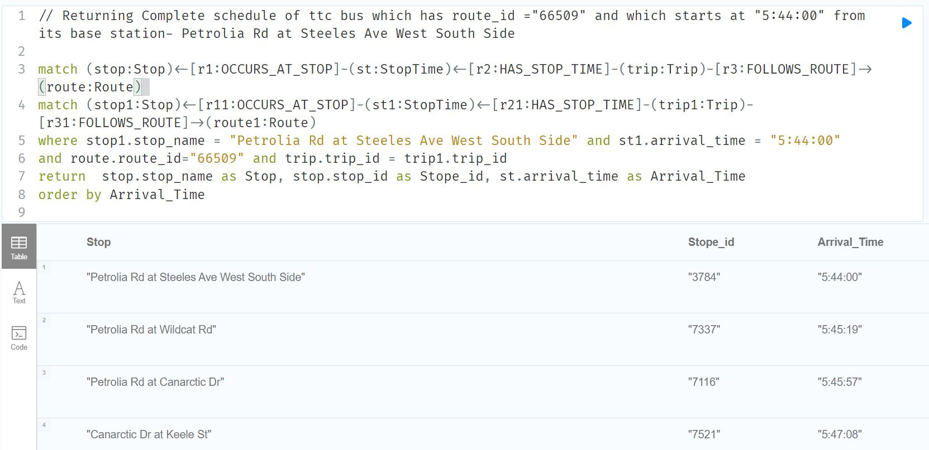
2. Hemant has reached one of the TTC end station (Petrolia Rd/ Steeles Av.) at 5:40 am to take a ride on Bus no. 66509 (which is actually a route no.). He doesn’t have any idea when and where to get off the bus. This query would help him to know the full schedule of the bus for this route.

Slide 19
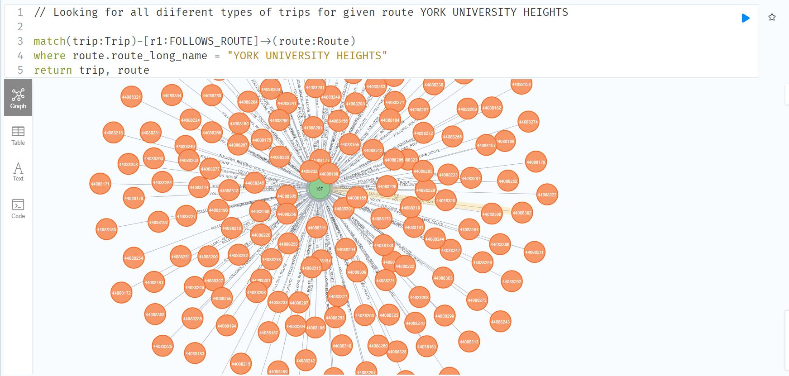
3. There can be many trips for one single route: one because one route complete can be covered by multiple trips (each trip contributing partially) and second TTC vehicles covers the same trip/route multiple time a day. This query is for the analysis of how busy can be the particular route.

Slide 20
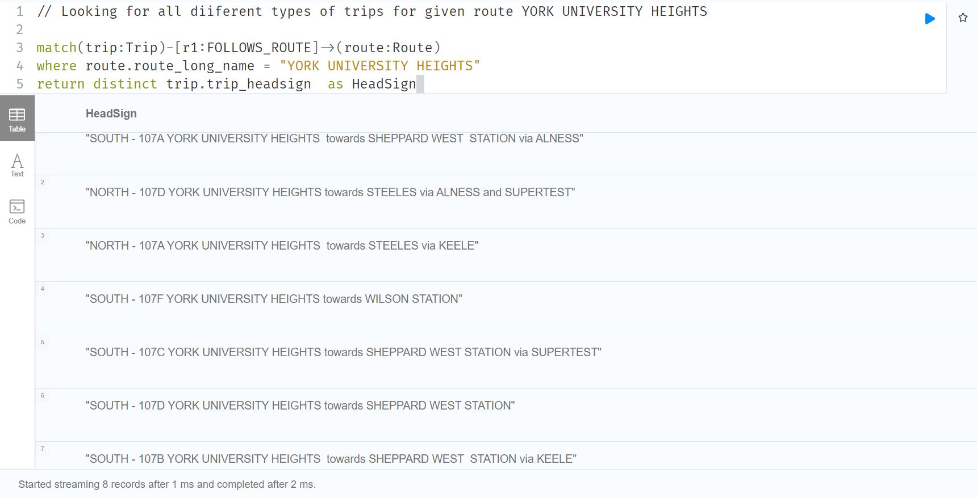
3. Continuing with the last slide, similar trips which cover exactly the same path are removed by using distinct keyword and returning the Head sign of the trips. Here, one can see we have eight different type of trips which runs on same route. (not entirely, but only partially)

Slide 21
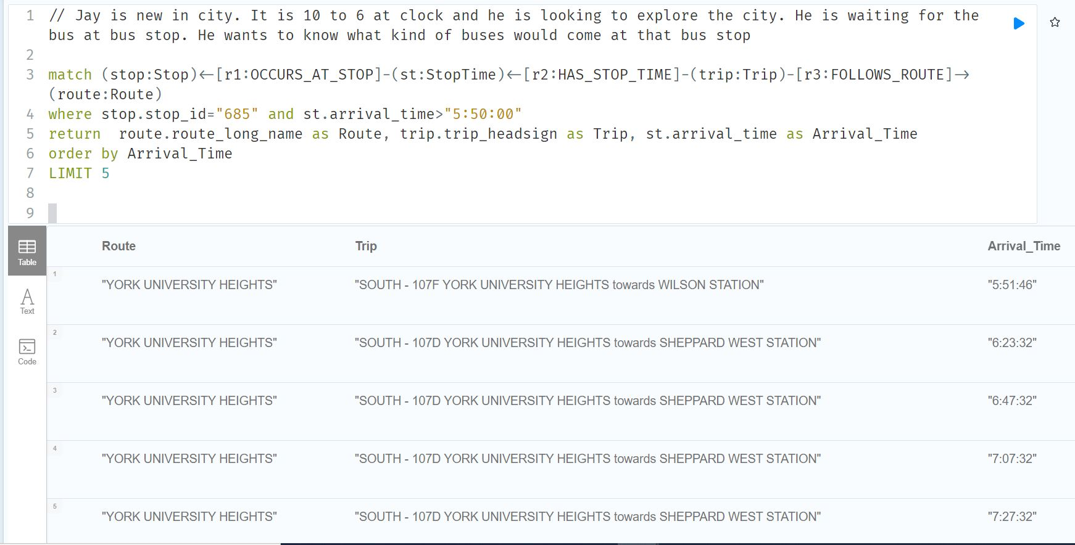
4. Jay is new in city and time is 5:50 pm and he is outside to explore the beautiful summers in Toronto. He is waiting for the bus at the bus stop. He wants to know what kind of buses (routes/trips) would come at that bus stop.

Slide 22
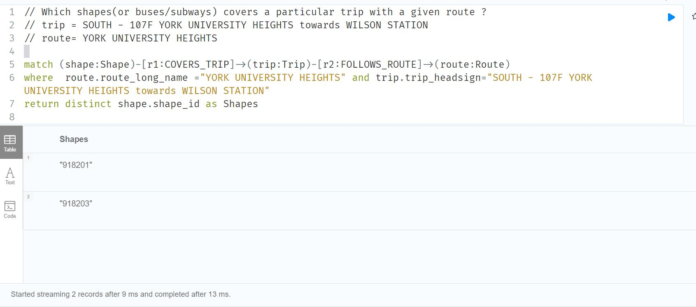
5. This analysis is done to know the buses which run on a particular route. (Here shape numbers which are returned, are actually the 6-digit assigned TTC vehicles). This query would help us to know how good is the bus service on any particular route. More the number of buses we have in our results, more good is the service.

Slide 23
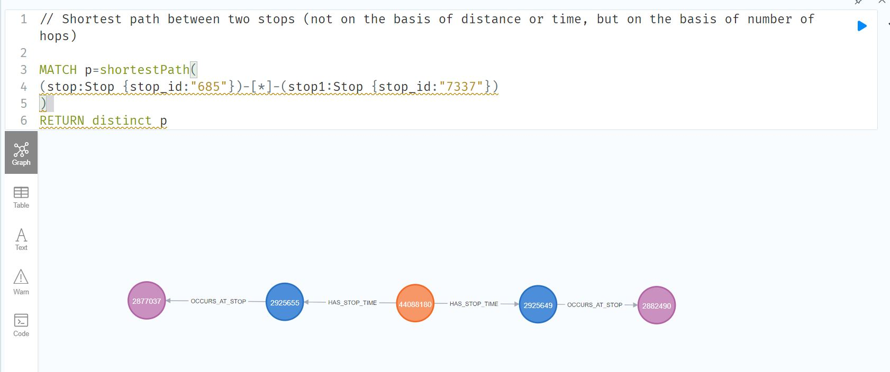
6. The following query is used to find the shortest path we can start from one stop and reach to other stop. Here shortest path doesn’t mean by the distance in Kilometers or time in hours. Shortest Path here means how many buses one has to change for travelling from source to destination.

Slide 24
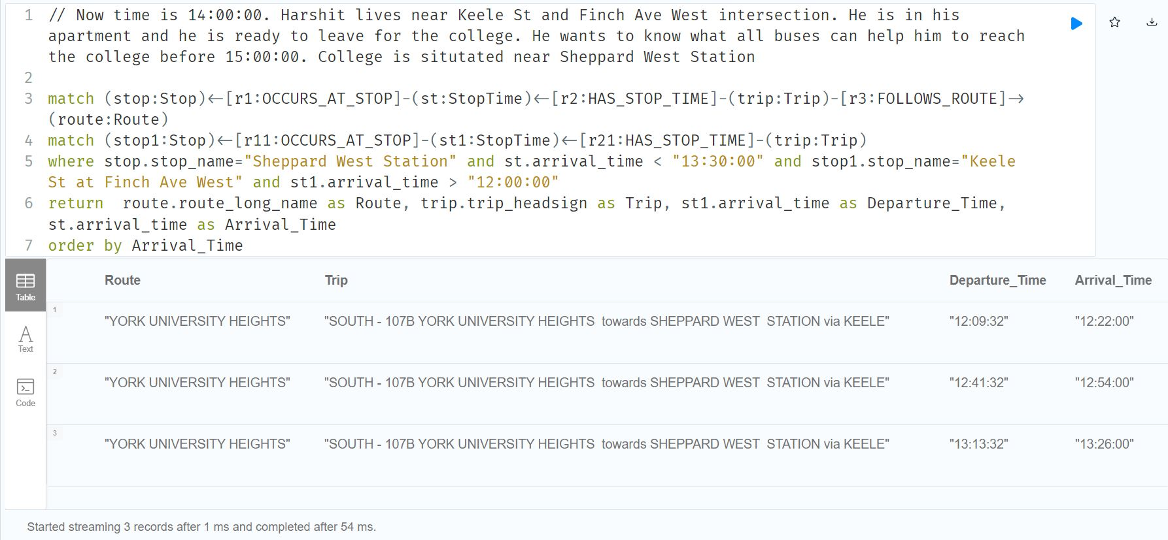
7. Harshit lives near Keele St and Finch Ave West intersection. He checks the clock and it is 2 pm. He is in his apartment and he is ready to leave for the college. He wants to know what all buses can help him to reach the college before 1:30 pm. College is situated near Sheppard West Station

Slide 25
Conclusions:
Different buses coming at any particular bus stop can be learnt.
Analysis can be done for on particular bus (route/trip) to know the full schedule of the bus.
One can know the buses which can pick the riders after one particular time at one particular stop and can drop them at the destination stop before some specific time.
Frequency of the buses (shapes) for some particular route can be learnt.
We can learn how many buses one has to change or how many bus stops one has to switch (like from North to East etc.) to reach from source to destination.
We can retrieve longer routes TTC has and these longer routes can be bifurcated into sub routes if there are considerable amount of delay.

Slide 26
Any Questions ???

Slide 27
Thank You
Hemant Kansal

